Slide 1


GLOBAL HEALTH
EXPENDITURE ANALYSIS
Analyzing global health expenditure data to gain valuable insights into various aspects of health spending across countries and regions.
Presenting By
Kumara Swamy Kongari

Slide 2


OVERVIEW
In this project, we will analyze global health expenditure data to gain insights into different aspects of health spending across countries and regions.
The dataset used in this project will contain information on health expenditure, GDP, population, and other relevant metrics.

Slide 3


OBJECTIVE
The objective of this Power BI project is to analyze global health expenditure data to gain valuable insights into various aspects of health spending across countries and regions.
The primary goal is to provide a comprehensive and data-driven view of health expenditure trends, and their relationships, and identify key patterns.
The analysis aims to answer critical questions and support decision-making in the field of global healthcare

Slide 4
DATA PRE-PROCESSING
1. The data contains detailed information about Global Health Expenditure of 2018-2020.
2.Used Power query editor to clean and transform the data, such as by removing duplicates, filling in missing values, splitting columns, and renaming tables.
3. I have used new measures and some DAX functions for the KPI visual, such as calculating Total GDP, Total Expenditure, % of Expenditure, Average Growth %, and Maximum Expenditure Country.
4. Created a dashboard with several visualizations, such as a card visual, slicers, stacked bar charts, line charts, scatter charts, and maps, to show the key insights.
5.Lastly applied some filters and slicers to allow interactive exploration of the data, such as selecting a country name and year.

Slide 5

Key Performance Indicators
Average Health Expenditure: $5.85K
Percentage of Health Expenditure: 38.93%
Population: 23M
Lowest Health Expenditure: Democratic Republic of the Congo with $54
Highest Health Expenditure: Monaco with $55.88K

Slide 6
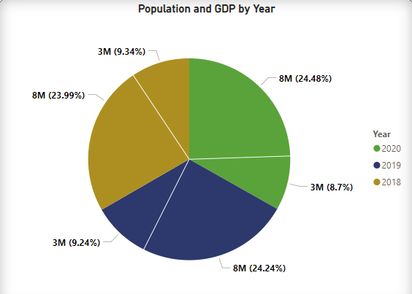
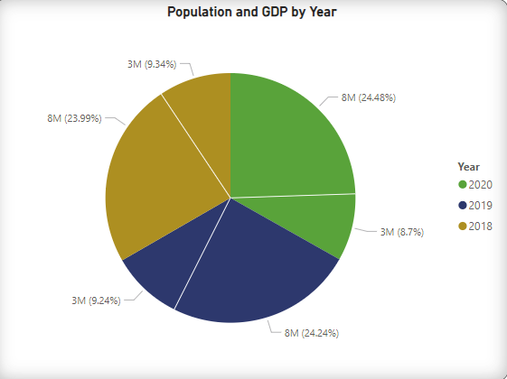
Key Visualizations
﻿2020 accounted for 33.67% of Population.﻿﻿ ﻿﻿ ﻿﻿
Population and GDP diverged the most when the Year was 2020, when Population were 4983598 higher than GDP.﻿﻿ ﻿

Slide 7
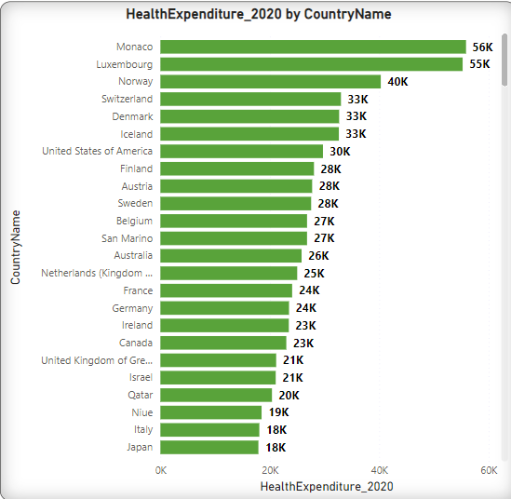
At 55875, Monaco had the highest HealthExpenditure_2020 and was 77,504.17% higher than Democratic Republic of the Congo, which had the lowest HealthExpenditure_2020 at 72.﻿﻿
Across all 191 Country Name, HealthExpenditure_2020 ranged from 72 to 55875.﻿﻿ ﻿﻿ ﻿

Slide 8
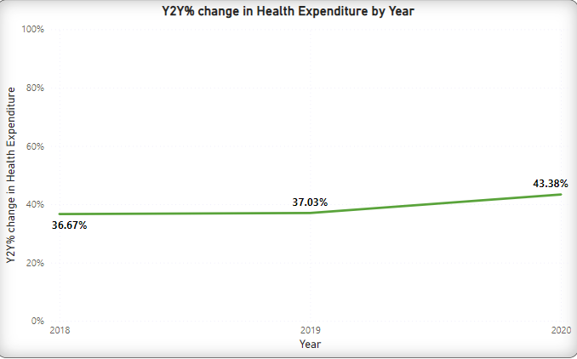
At 43.38%, 2020 had the highest Y2Y% change in Health Expenditure and was 18.30% higher than 2018, which had the lowest Y2Y% change in Health Expenditure at 36.67%.﻿﻿ ﻿﻿ ﻿﻿

Slide 9
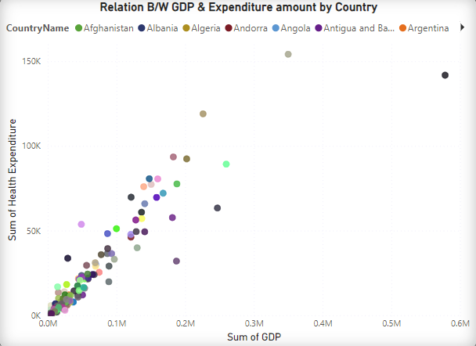
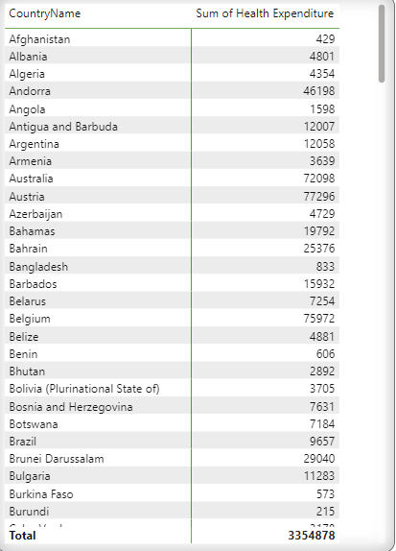
﻿Monaco had the highest Sum of GDP (578282) and Luxembourg had the highest Sum of Health Expenditure (154152).﻿﻿ ﻿﻿ ﻿

Slide 10

CONCLUSION
In analyzing the trends and distribution of health expenditure over the years 2018 to 2020, several key insights emerge:
Increasing Trend in Health Expenditure:
Consistent year-over-year (Y2Y) growth from 2018 to 2020.
Most significant growth in 2020 with a 43.38% increase.
Significant Rise in 2020:
Sharp rise in health expenditure suggests increased healthcare investment due to global health crises.
Contribution of Monaco:
In 2020, Monaco's health expenditure constituted 1.67% of the total health expenditures.
GDP and Health Expenditure Leaders:
Monaco led in GDP, while Luxembourg had the highest health expenditure.
Overall Trend:
Significant upward trend in health expenditures, especially in 2020.
Reflects increased healthcare needs and responses to global health challenges.

Slide 11
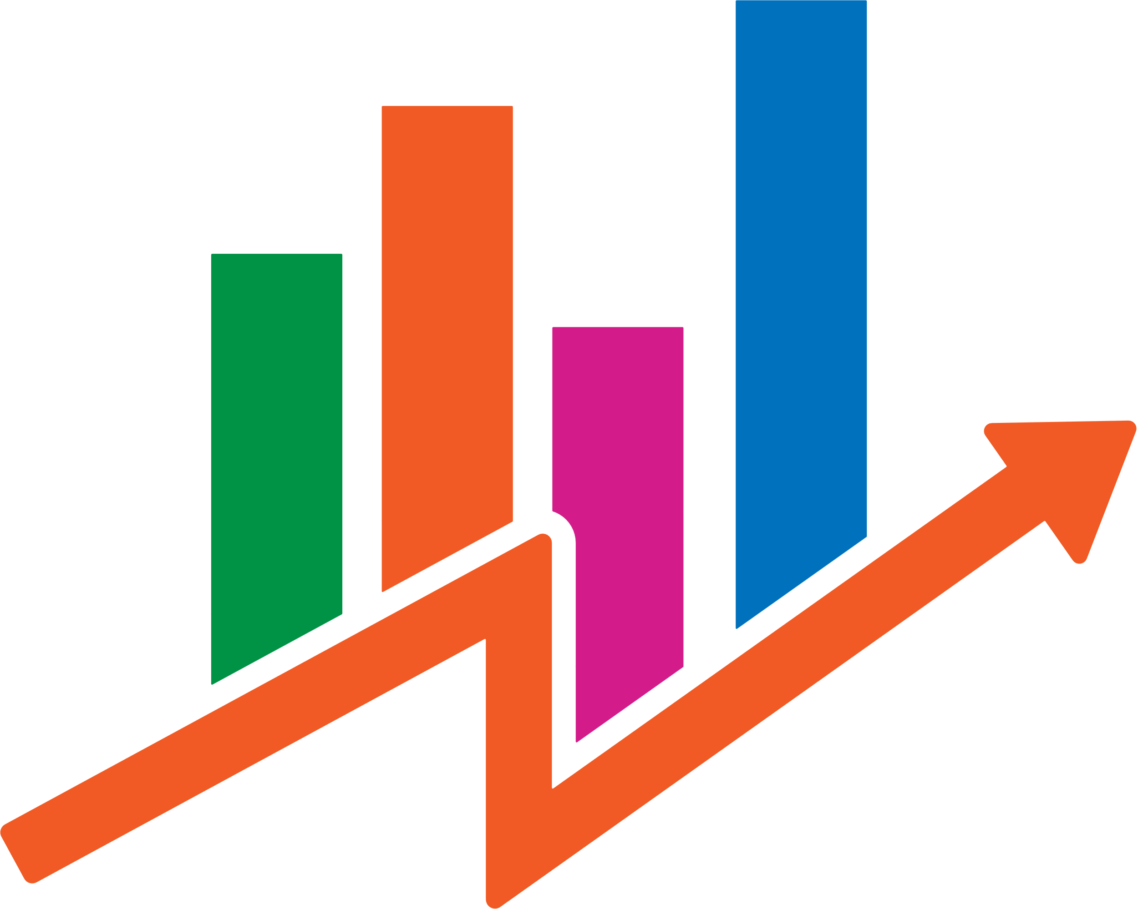
REPORT
The Health Expenditure remains constant/slightly deviated between 2018 and 2019. But in 2020, there is increase of around 1 lakh sum of health expenditure.
Monaco (55.8K), Luxembourg (55.2K) are two top leading countries which has highest health expenditure
The year to year percentage of health expenditure is 38.93%.
Democratic Republic of Congo (54) is the country with lowest health expenditure
The average health expenditure is 5.85K.

Slide 12
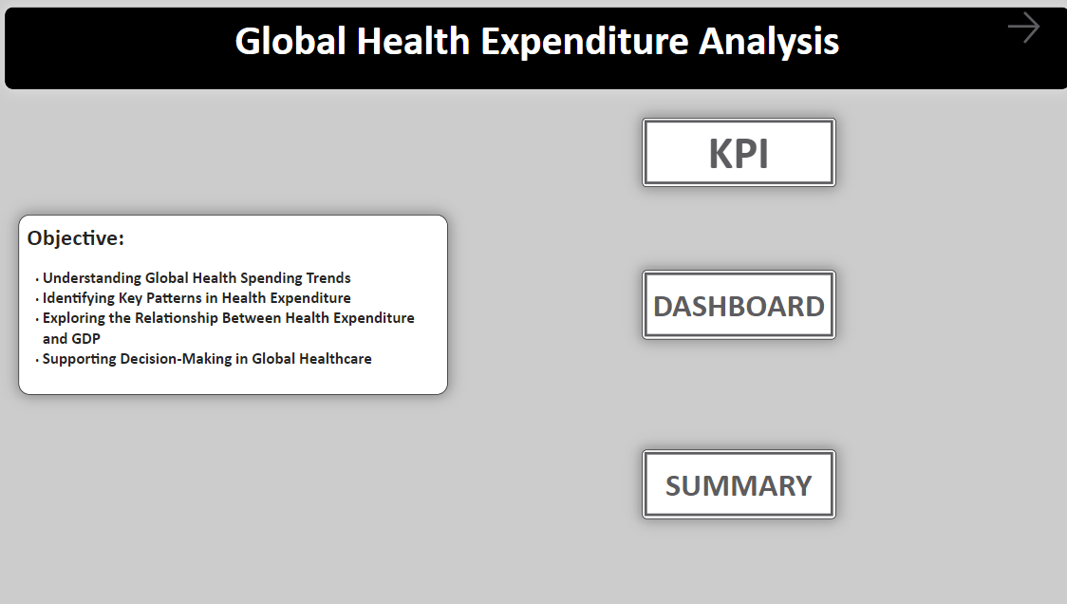
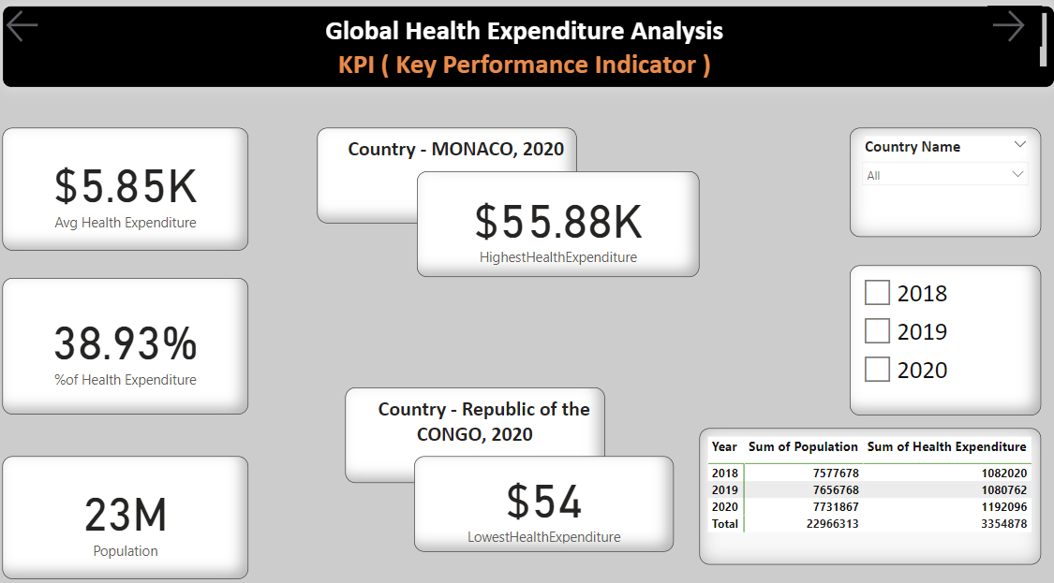
DASHBOARD
This is the report, I have created to analyze Global Health Expenditure

Slide 13
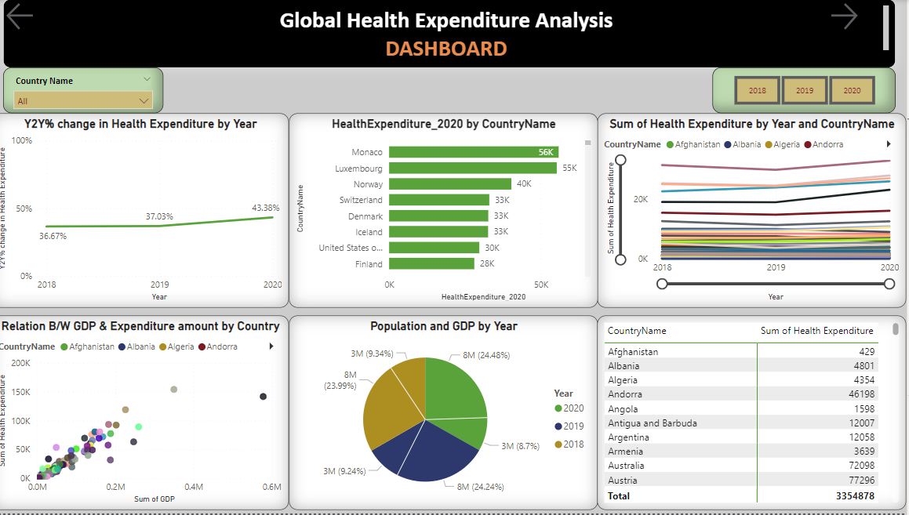
DASHBOARD

Slide 14
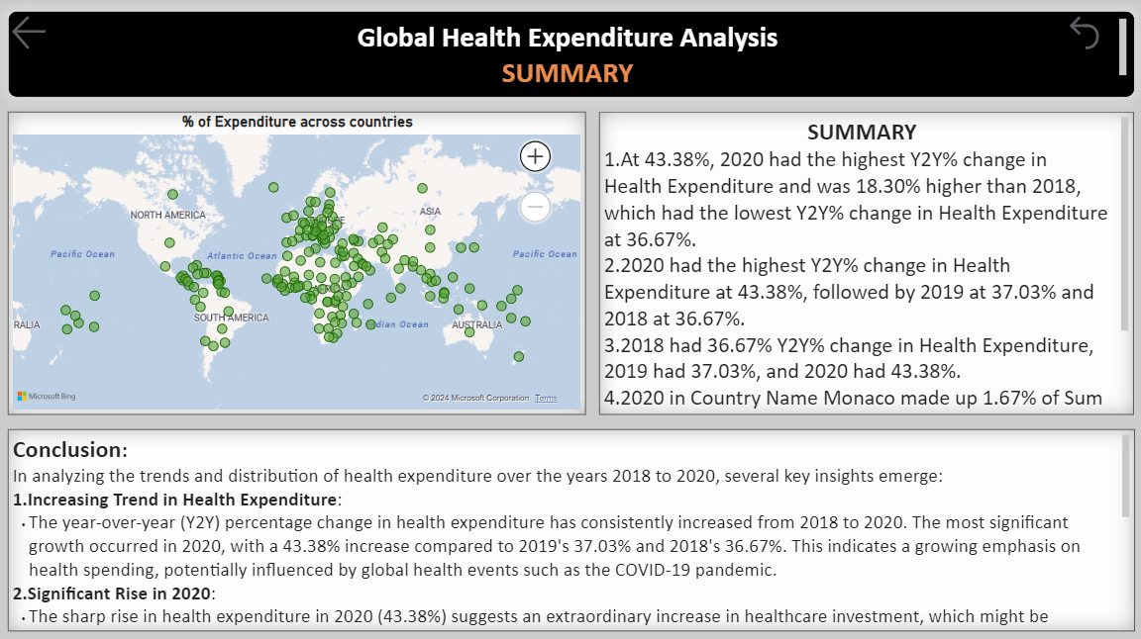
DASHBOARD

Slide 15
THANK YOU

